Slide 1
RTB Bidder Challenge
StartApp

Slide 2

Challenges: Model Selection
Target variable CTR is in the range $0≤CTR≤1$:
Classifiers (such as logistic regression) deal with class labels as target variables only:
threshold probabilities to 0/1 and interpret as class labels would lose a lot of information
Simple Regression models do not restrict the target variable:
no guarantee that the output on unseen data will be restricted to the 0/1 range.
Linear Regression (Simple, Lasso, Ridge)
Tree Based Models (Random Forests)
GLM (Beta Binomial)
Deep neural networks

Slide 3
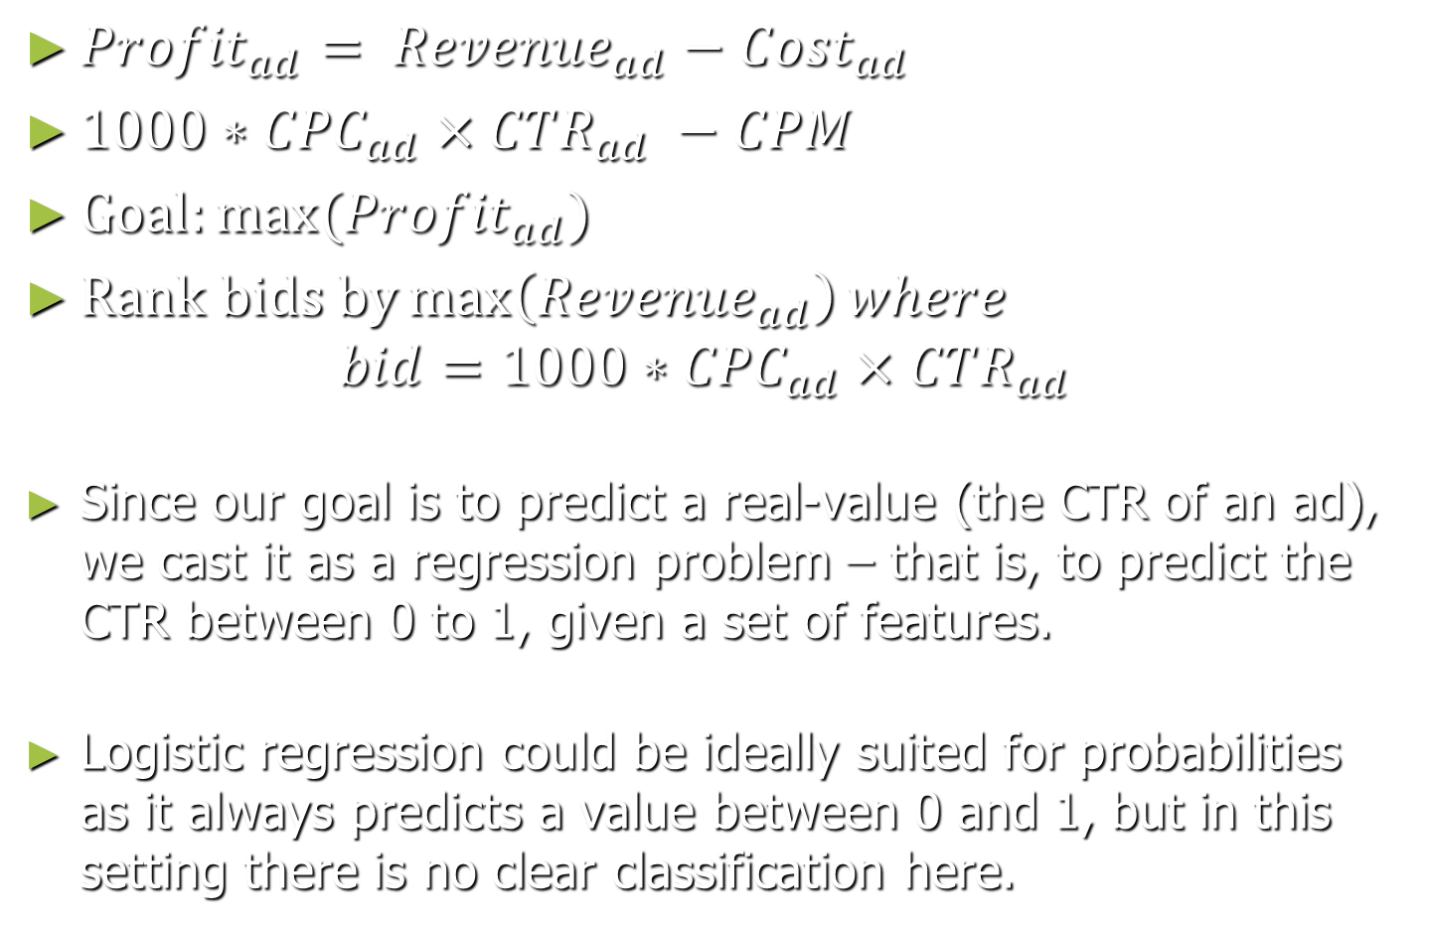
Goal: Maximize Profit
${Profit}_{ad}= {Revenue}_{ad}−{Cost}_{ad}$
${1000∗CPC}_{ad}×{CTR}_{ad} −CPM$
$Goal:max⁡({Profit}_{ad})$
$Rank bids by\max\left({Revenue}_{ad}\right)where$
$$bid=1000∗{CPC}_{ad}×{CTR}_{ad}$$
Since our goal is to predict a real-value (the CTR of an ad), we cast it as a regression problem – that is, to predict the CTR between 0 to 1, given a set of features.
Logistic regression could be ideally suited for probabilities as it always predicts a value between 0 and 1, but in this setting there is no clear classification here.

Slide 4
Challenges: Feature Extraction
Unseen new data, Accidental clicks, Fraudulent adds
0/1 vs. 0/100 vs. 1/10 vs. 2/10 vs. 1/500 and so on…
Training Time & Memory usage
Feature extraction & Dependent variable

Slide 5
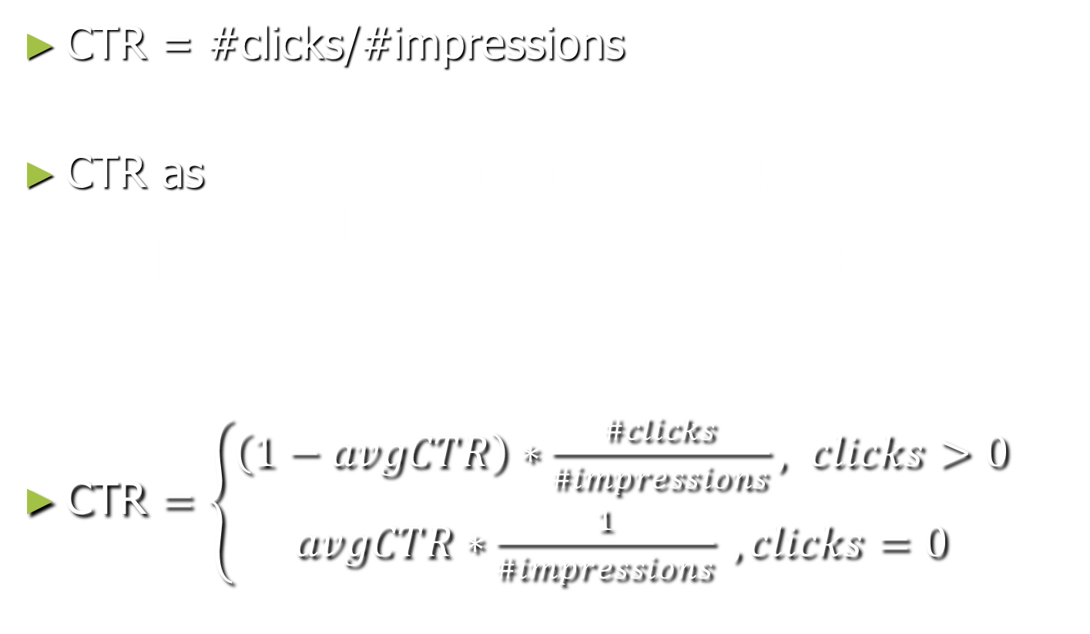
Challenge: Formulating the Response
CTR = #clicks/#impressions
CTR as posterior probability of $p\left(θ|x\right)$:
$$p\left(θ|x\right)=\frac{p\left(x|θ\right)p\left(θ\right)}{p\left(x\right)} \sim Beta\left({α+k}_{i},{β+n}_{i}−k_{i}\right)$$
CTR $=\left\{\begin{aligned}\left(1−avgCTR\right)∗\frac{\#clicks}{\#impressions}, clicks>0 \\ &avgCTR∗\frac{1}{\#impressions} ,clicks=0\end{aligned}\right.$

Slide 6
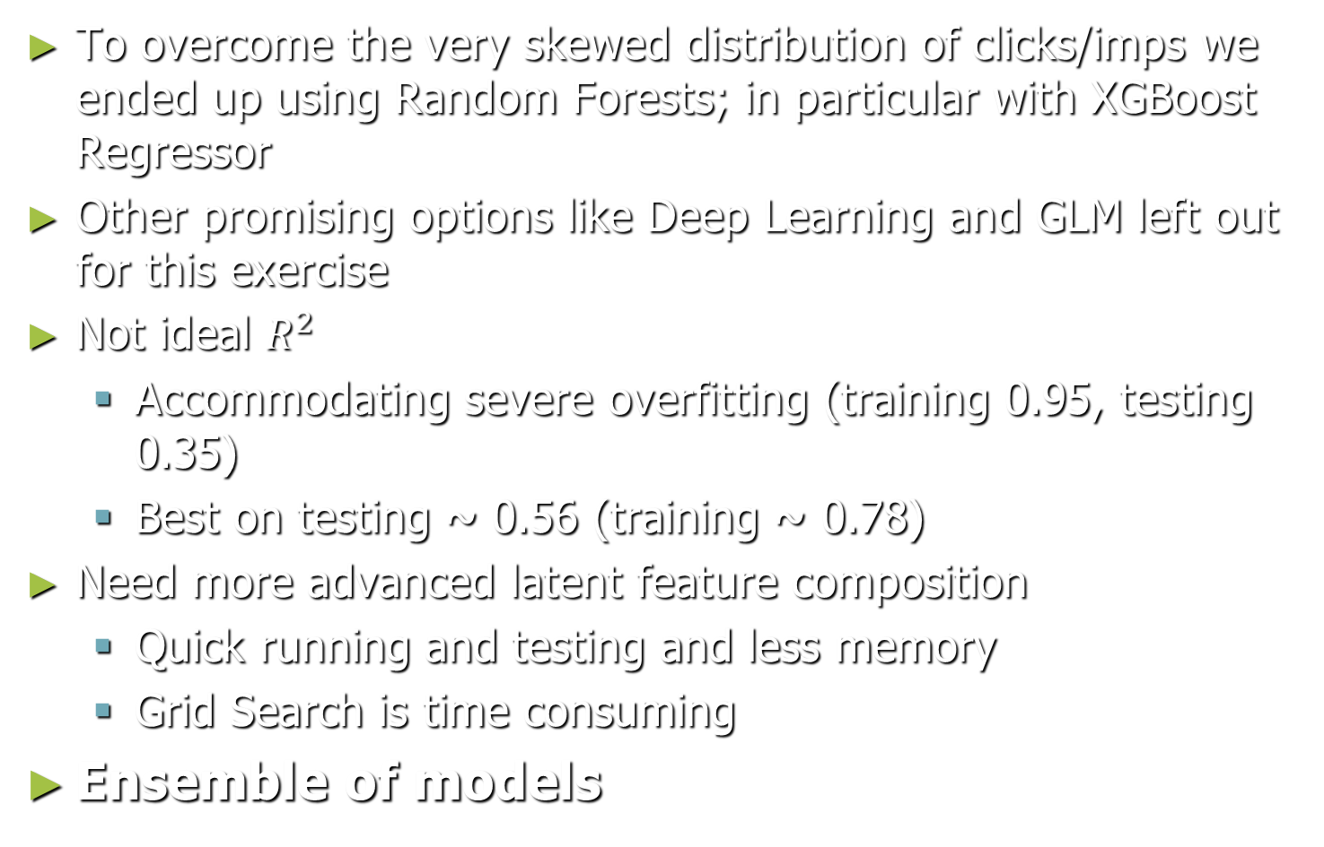
Results:
To overcome the very skewed distribution of clicks/imps we ended up using Random Forests; in particular with XGBoost Regressor
Other promising options like Deep Learning and GLM left out for this exercise
Not ideal $R^{2}$
Accommodating severe overfitting (training 0.95, testing 0.35)
Best on testing ~ 0.56 (training ~ 0.78)
Need more advanced latent feature composition
Quick running and testing and less memory
Grid Search is time consuming
Ensemble of models

Slide 7
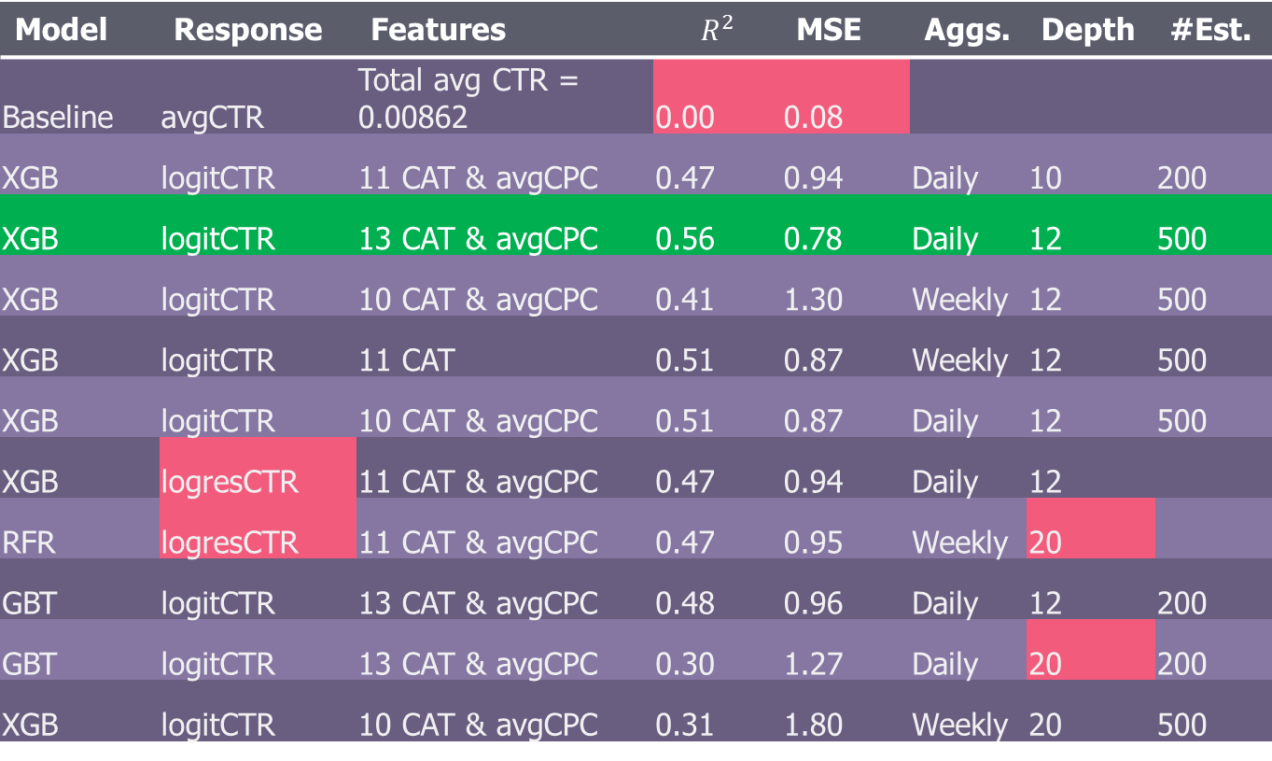
Results:
Model | Response | Features | $$R^{2}$$ | MSE | Aggs. | Depth | #Est.
Baseline | avgCTR | Total avg CTR = 0.00862 | 0.00 | 0.08
XGB | logitCTR | 11 CAT & avgCPC | 0.47 | 0.94 | Daily | 10 | 200
XGB | logitCTR | 13 CAT & avgCPC | 0.56 | 0.78 | Daily | 12 | 500
XGB | logitCTR | 10 CAT & avgCPC | 0.41 | 1.30 | Weekly | 12 | 500
XGB | logitCTR | 11 CAT | 0.51 | 0.87 | Weekly | 12 | 500
XGB | logitCTR | 10 CAT & avgCPC | 0.51 | 0.87 | Daily | 12 | 500
XGB | logresCTR | 11 CAT & avgCPC | 0.47 | 0.94 | Daily | 12
RFR | logresCTR | 11 CAT & avgCPC | 0.47 | 0.95 | Weekly | 20
GBT | logitCTR | 13 CAT & avgCPC | 0.48 | 0.96 | Daily | 12 | 200
GBT | logitCTR | 13 CAT & avgCPC | 0.30 | 1.27 | Daily | 20 | 200
XGB | logitCTR | 10 CAT & avgCPC | 0.31 | 1.80 | Weekly | 20 | 500

Slide 8
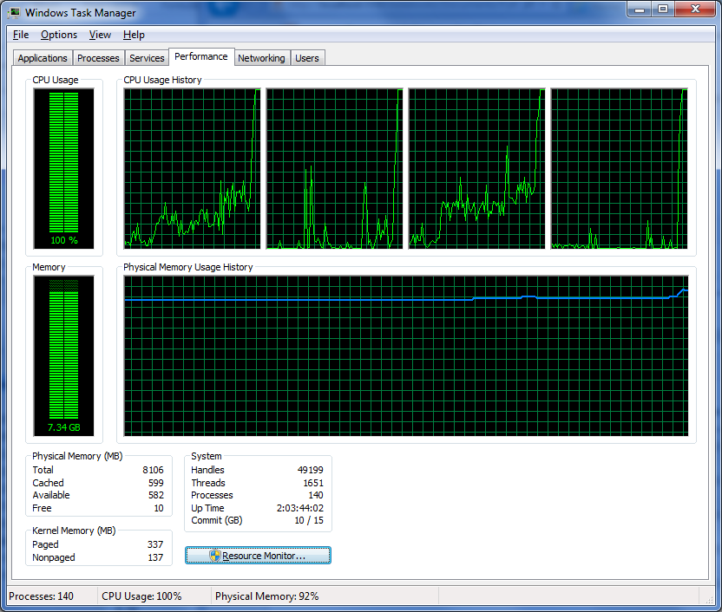
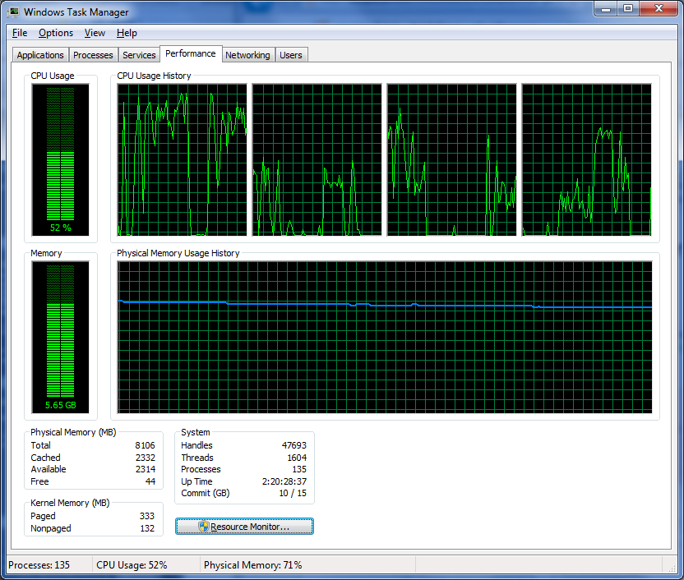
Miscellaneous:

